Slide 1
CatFeeder Electronics
(and test program)

Slide 2
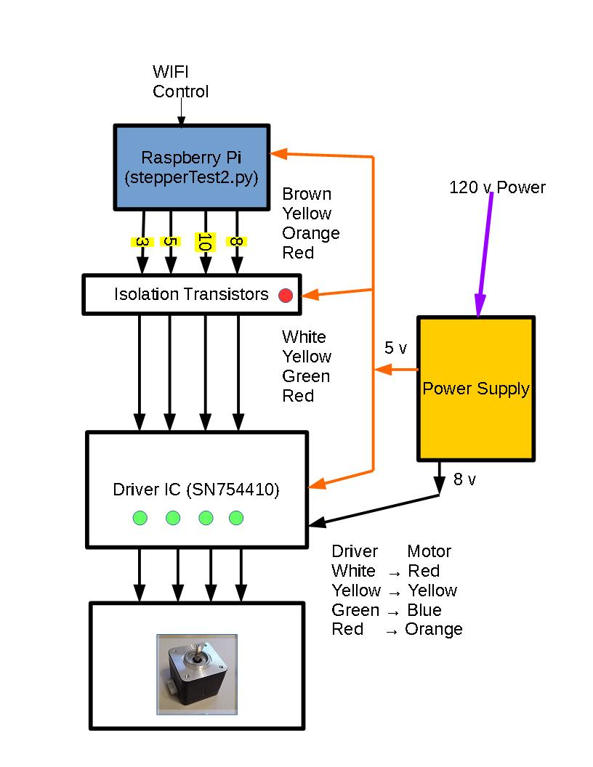
Block Diagram

Slide 3
GPIO Libraries
Drives Servoblaster controlled servo
https://github.com/richardghirst/PiBits/tree/master/ServoBlaster
Another Servoblaster
http://raspiprojects.com/install-servoblaster-raspberry-pi-control-servo-python.html
Another Servoblaster related w/ demon
http://raspberrypi.stackexchange.com/questions/27222/controlling-a-continuous-servo-with-raspberry-pi
Ernest uses GPIOZero Library
https://gpiozero.readthedocs.io/en/v1.3.1
The library I use in this demo
sudo apt-get install python3-rpi.gpio
https://sourceforge.net/p/raspberry-gpio-python/wiki/Home/ # Documentation

Slide 4
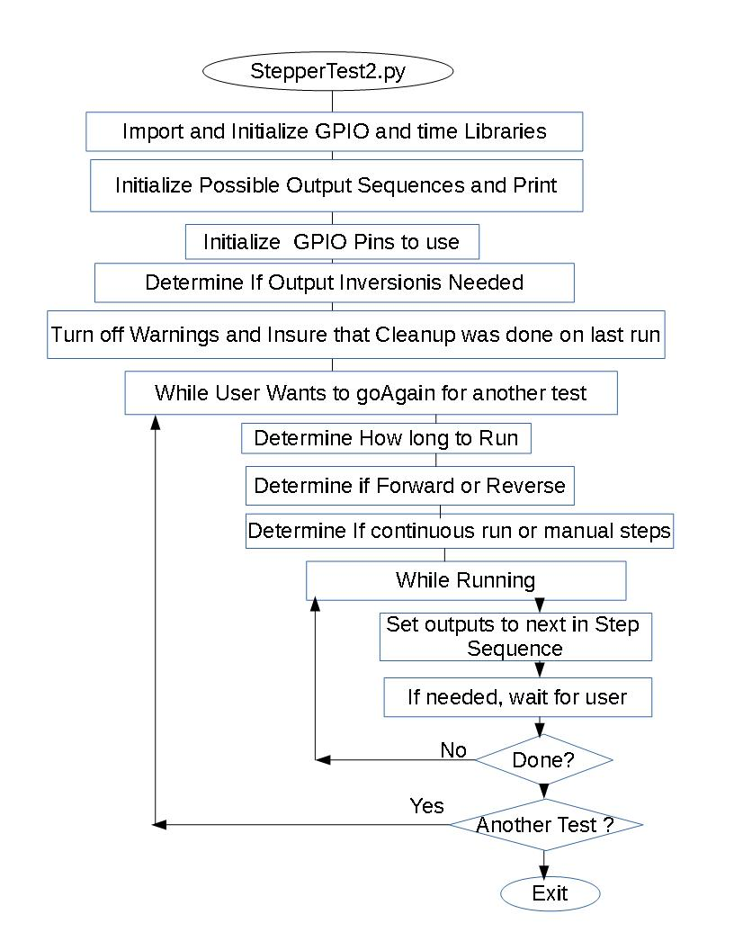

Slide 5
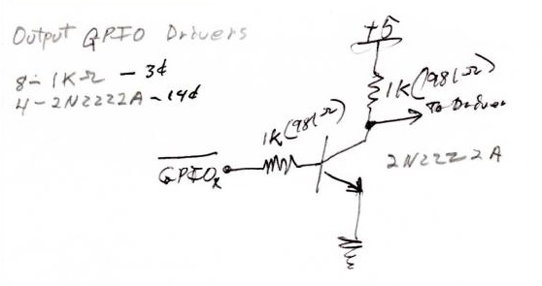
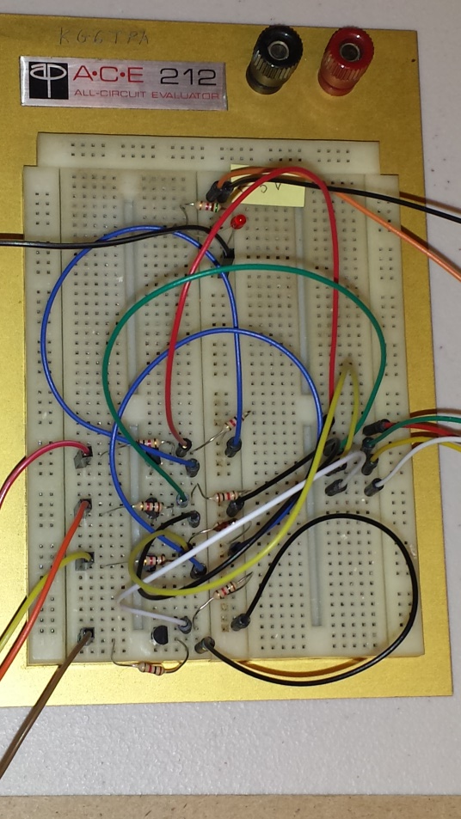
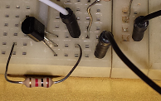
Isolation Transistors

Slide 6
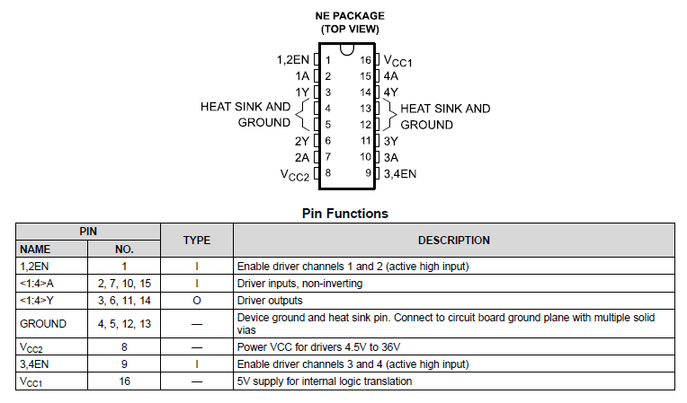
SN754410 Driver IC Pin Out

Slide 7
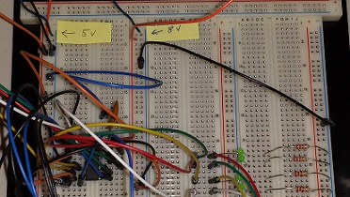
Driver IC Connections

Slide 8
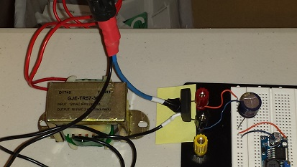
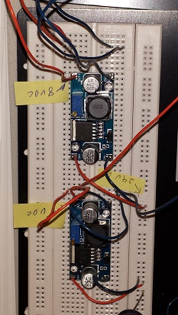
Power Supply

Slide 9
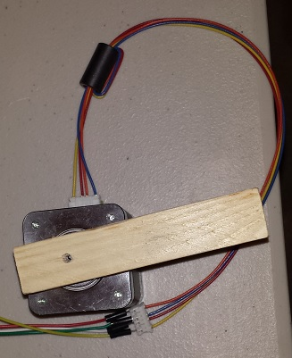
Stepper Motor

Slide 10
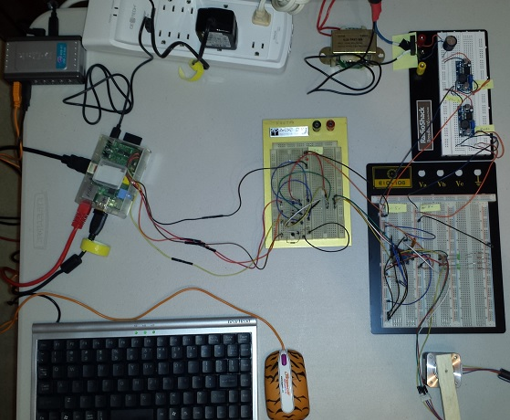
All the parts

Slide 11
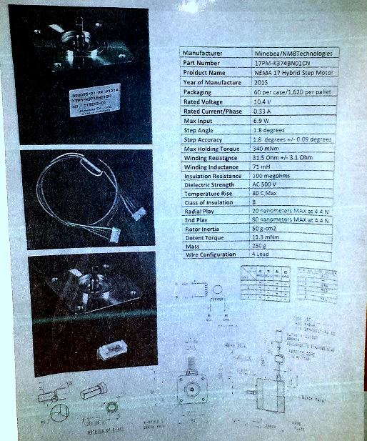
Spec Sheet for the Motor

Slide 12
Demo
Stepping the motor
Running the motor

