Slide 1
NW Digital Radio’s DV3000
D-STAR DV Add On Card for UDRX/R-Pi

Slide 2
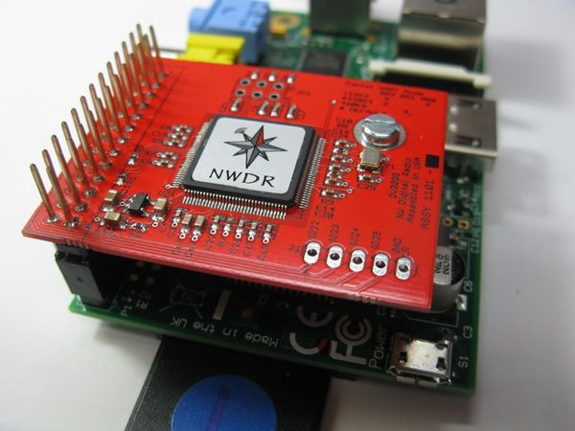
What is the DV3000?
A Raspberry Pi Add-On Card.
Contains an AMBE-3000 Chip.
Allows Digital Voice Encoding and Decoding.
  Specifically Icom D-STAR
  Also, Yaesu Fusion, Motorola DMR, and Motorola dPMR
Listed at $99.95
Notes:
D-STAR is a registered trademark of Icom
DMR stands for Digital Mobile Radio
dPMR stands for Digital Private Mobile Radio

Slide 3
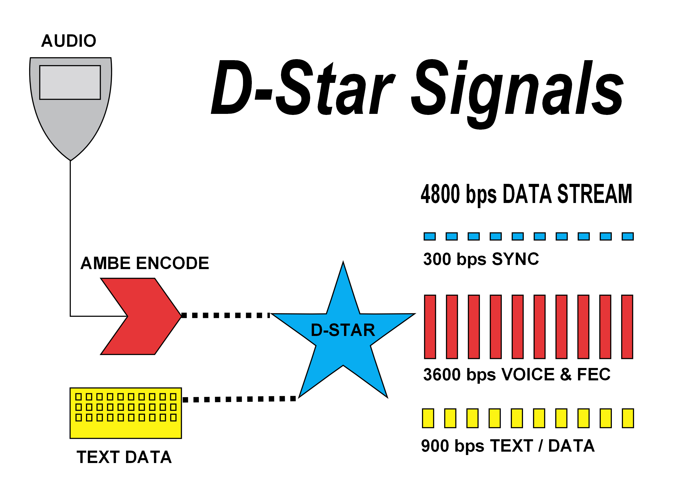
What is D-STAR?
D-STAR is a registered trademark of Icom.
D-STAR stands for “Digital Smart Technologies for Amateur Radio”.
Specification developed by the Japan Amateur Radio League for amateur radio.
Uses a closed-source proprietary voice codec (AMBE) that's patented by Digital Voice Systems, Inc. (DVSI).
Some Controversy

Slide 4
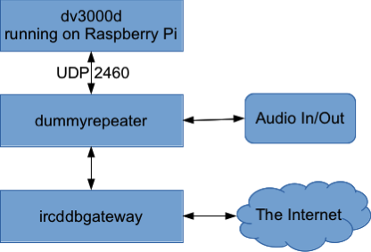
Software on the Raspberry Pi
dv3000d – a Linux daemon that exposes the AMBE3000 to the network.
Dummy Repeater – Linux software that knows how to encode and decode audio.
ircDDB Gateway – allows Dummy Repeater to connect over the Internet.

Slide 5
Demonstration

