Slide 1
COR Sprinkler Project
How to use a Raspberry Pi to defeat city lawn & plant watering schedules.

Slide 2
The Problem
City of Richardson and other cities have a water schedule typical sprinkler systems can not meet. I.e. “Even number house with alternating days, #1130 – 1st & 3rd, Saturday (months with 3 weekends mess this up.)
Some new sprinkler controllers have web access but keep existing manual schedules.

Slide 3
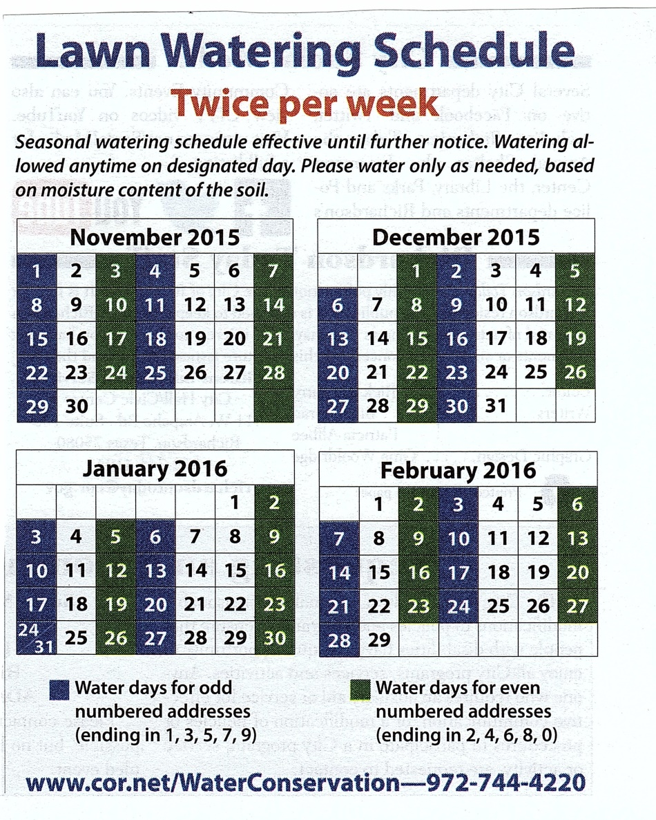
Recent Schedule

Slide 4
Raspberry Pi Approach
Hardware First
  OpenSprinkler Pi (kit, no kit) http://rayshobby.net/opensprinkler/
  Raspberry Pi A,B, B+, 2
  TP Link WiFi
  Hobby Box
Then Rpi Software
  https://github.com/rayshobby/opensprinkler
  Features
    Google Calendar scheduling (demo)
    Multiple control programs
    Email alerts (manual add)

Slide 5
Hardware List
New or existing installation ( Mine $133)
  Raspberry Pi + SD Ram for OS & programs 4GB
    $32
  OpenSprinkler kit
    $78
  24vac power brick
    $10
  Internet access, cable or WiFi module (TP-Link)
    $19
  Installed sprinkler heads, with station valves
  Plastic BUD box to house electronics
    $4

Slide 6
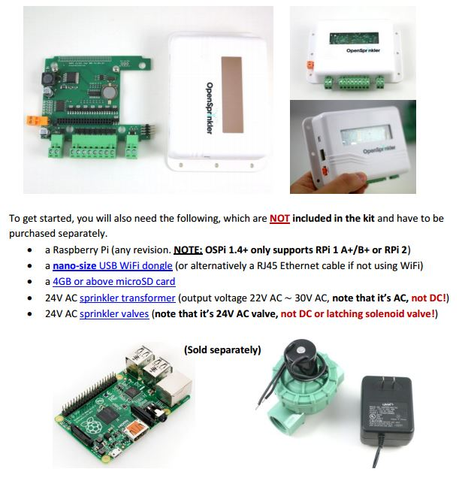
My Installation

Slide 7
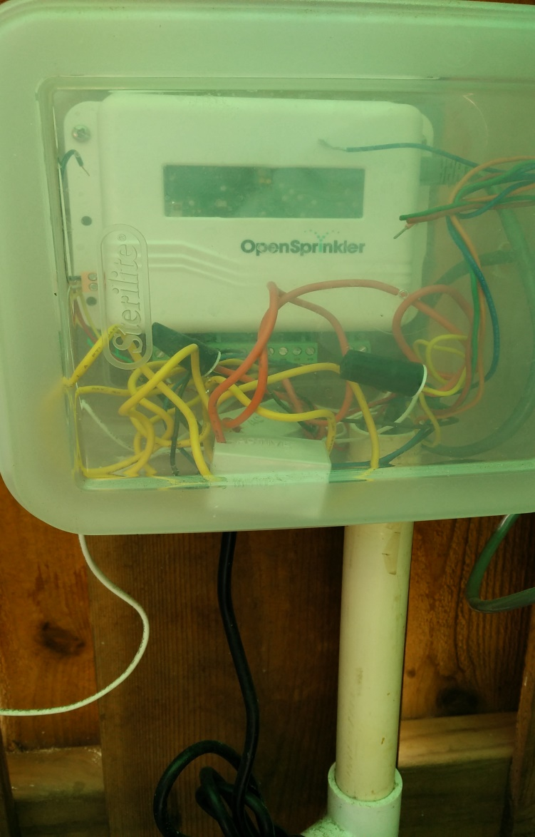
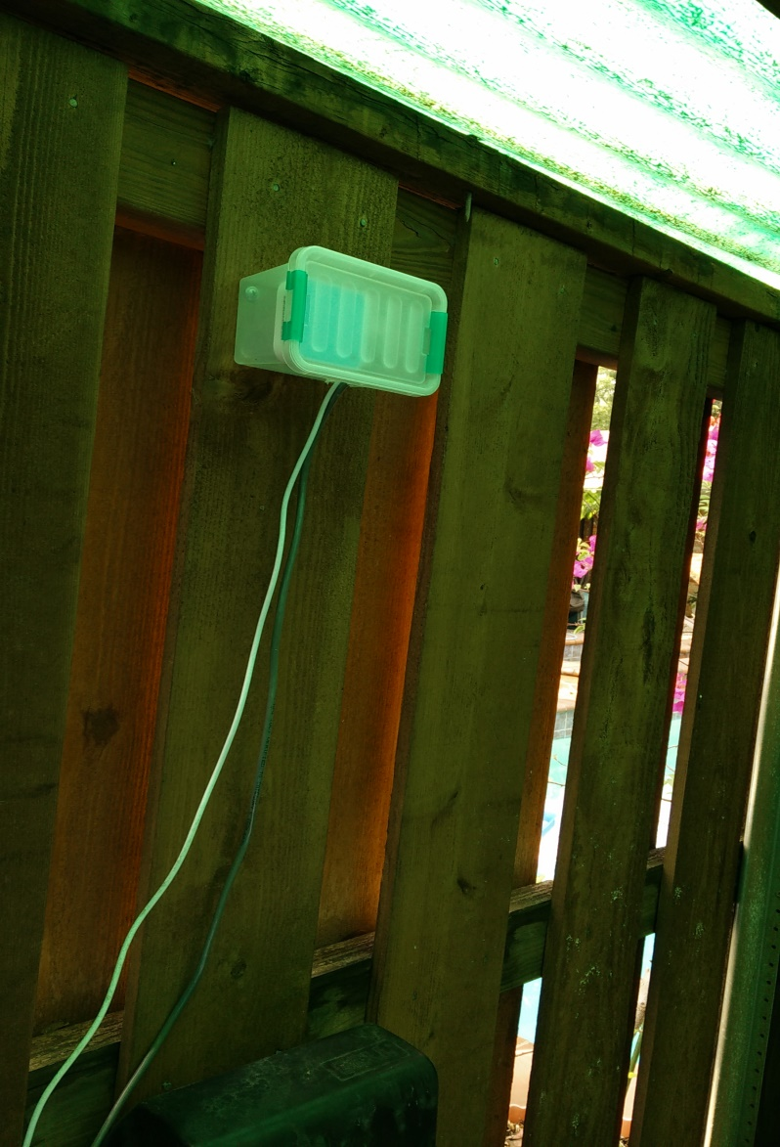
Actual install in my pool shed
Rain/Snow detector

Slide 8
Software
Download base program:
  https://opensprinkler.freshdesk.com/support/solutions/articles/5000524845-initial-configuration-of-raspberry-pi
  Then the manual :
  https://opensprinkler.freshdesk.com/support/solutions/articles/5000631606-user-manual-opensprinkler-pi-ospi-v1-4-
  Transfer to the SD Ram
  Fire up the Raspberry Pi and start the edits.
  Install and email server for notices.

Slide 9
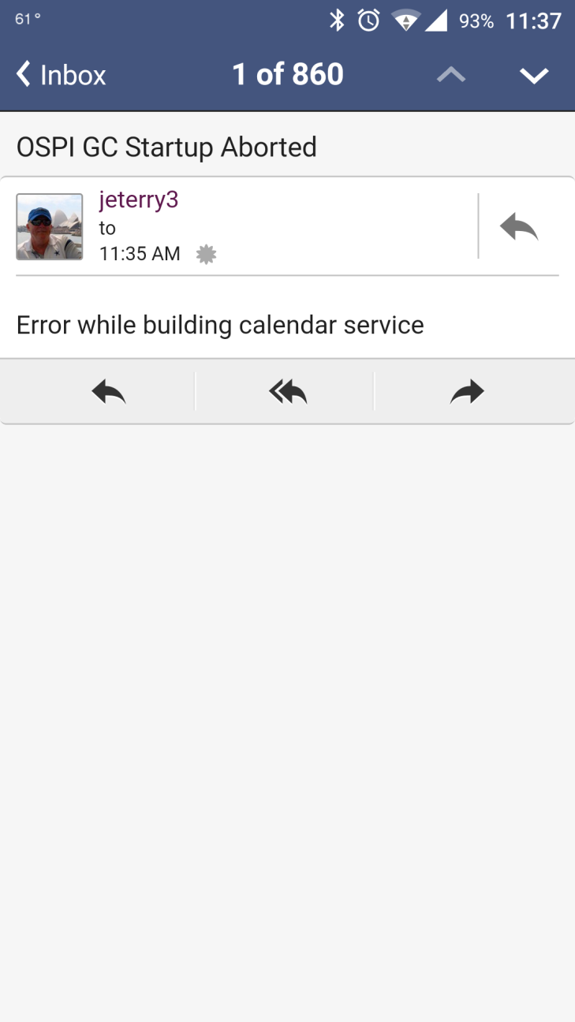
Needs better notice

Slide 10
Files to Edit
Many of the files in my system have been modified by a friend named Jason. He is a hard working TI employee and as we did this together he did the changes for a begalbone system vs a Raspberry Pi. Him having Linux experience and me havening none! He posted his updates on Github.
Google Calendar needs a programmer key.
Live system access using MobaXterm

Slide 11
First steps
Open the manual and follow directions:
  RaspberryPi\ospi14_manual.pdf
Out of 3 built in programs, trial and error led us to use just one with google calendar.
  https://github.com/rszimm/sprinklers_pi/wiki
  Edit gcalendar file
    /home/pi/demo/gcalendar/ospi_gc.py

Slide 12
Left to Do
Decide to follow updates in firmware or not
Finalize calendar management; stay with Google or not?
Centralize user editable files, except for email setup
Make .iso for general distribution
Ed Terry – jeterry3@fastmail.com

